Slide 1
The Science of Colour

Slide 2
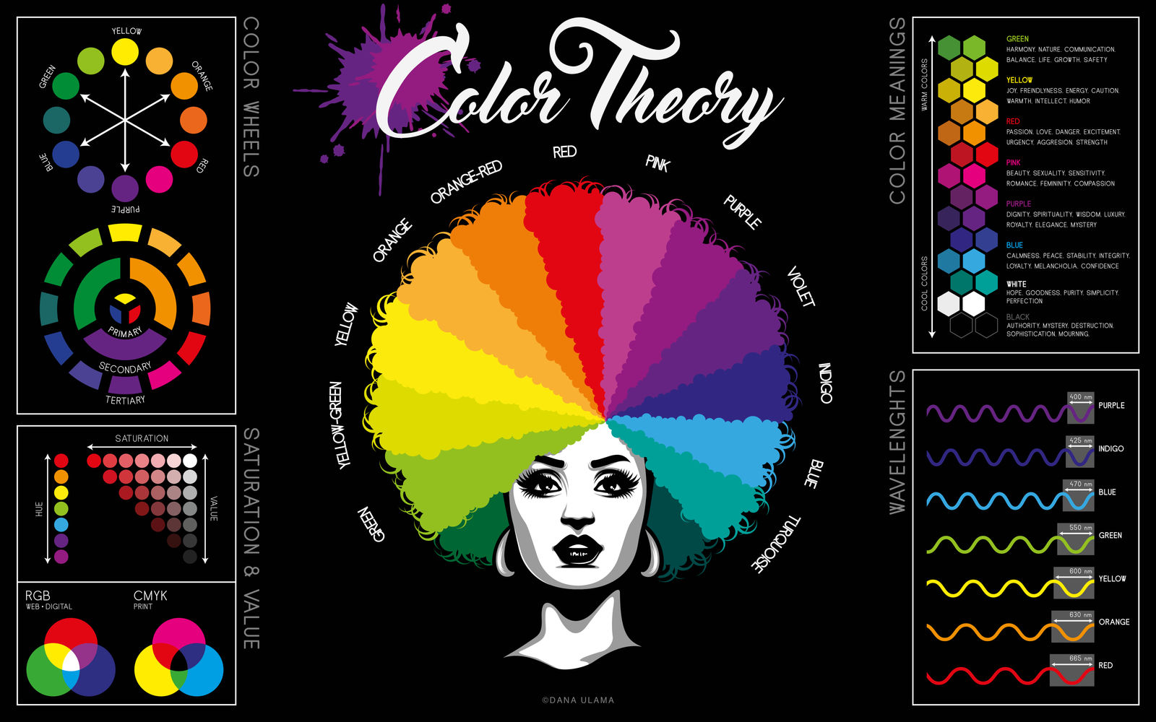
Colour Theory
Notes:
So what is Colour
In a physical sense, there is really no such thing as colour, just light waves of different wavelengths.
The human eye can distinguish among these wavelengths, so we see the world in colour. Rays of light vibrate at different speeds. The sensation of colour, which happens in our brains, is a result of our vision’s response to these different wavelengths.
When taken together, the various rays our eyes can distinguish are called the visible spectrum.
Image from:
https://sl.bing.net/ZhV6pVROSa

Slide 3
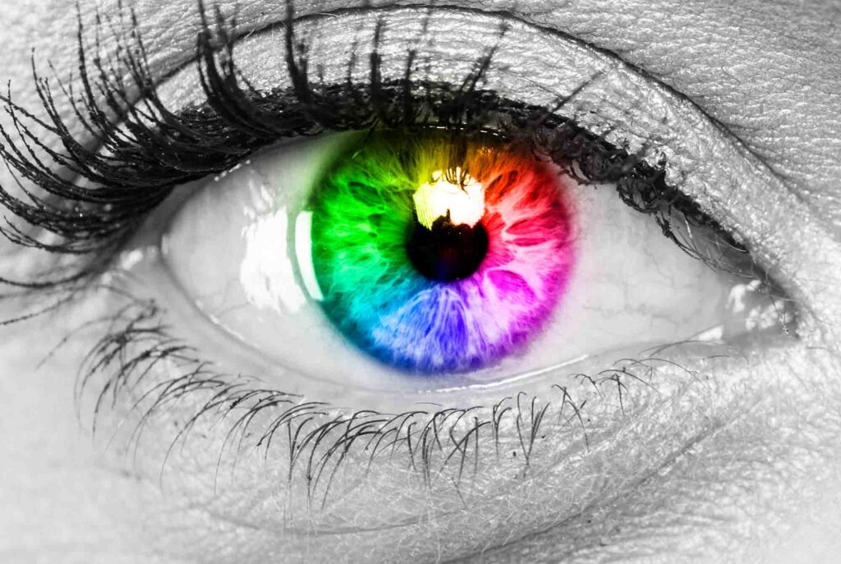
Seeing in colour
Colour is derived from light, either natural or artiﬁcial.
There are two types of primary colours: additive and subtractive
Notes:
Colour is derived from light, either natural or artiﬁcial.
With little light, little or no colour is present.
With a lot of light comes lots of colour.
Strong light produces intense colour.
There are two types of primary colours: additive and subtractive
Our eyes have red, green, and blue (RGB) colour receptors. RGB are the primary colours of pure light and are referred to as additive primary colours.
The subtractive primary colours, made from reﬂected light, fall into two types: the printer’s primaries, which are cyan, magenta, and yellow (CMY), and the artist’s primaries, which are red, yellow, and blue (RYB).
Image from: https://sl.bing.net/h5VEEg8erIG

Slide 4
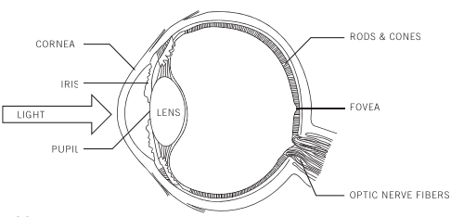
How the Eye Sees Colour
Light enters through the pupil
Retina contains rods and cones
Cones detect colour
Three cone types:
  Red-sensitive
  Green-sensitive
  Blue-sensitive
Notes:
When we talk about colour, we often think of it as a property of an object. In reality, colour begins as light.
Light enters through the pupil and is focused onto the retina at the back of the eye.
The retina contains two types of photoreceptors: rods and cones.
Rods help us see light and dark and work well in dim lighting.
Cones are responsible for colour vision.
Humans typically have three types of cone cells that respond most strongly to red, green, and blue wavelengths.
These receptors send information to the brain where colour is actually interpreted.
Image from https://calgary.rasc.ca/lp/lightandtheeye.html

Slide 5
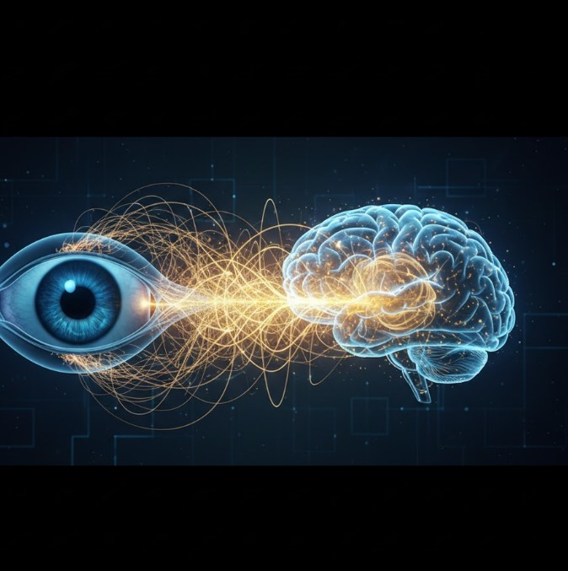
The Brain Interprets Colour
Colour exists in perception
Brain compares wavelengths
Context influences interpretation
Colour is not always objective
Notes:
What we call colour does not exist inside objects.
Objects only reflect certain wavelengths of light.
The eye captures those wavelengths, but the brain decides what colour we perceive.
This is why two people can sometimes disagree about colour.
Our brains compensate for lighting conditions and surrounding colours.
This becomes important when making design decisions because users may not all perceive colour exactly the same way.
Image from: https://sl.bing.net/iyOrrBC36FU

Slide 6
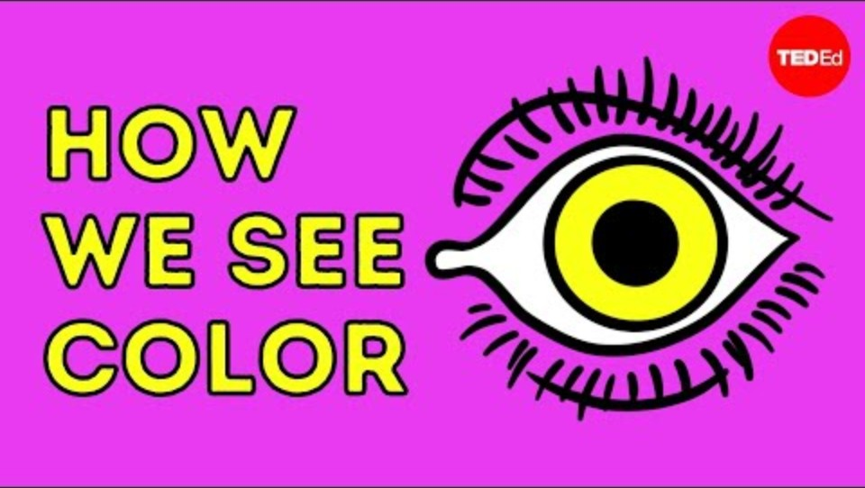
TED-Ed: How We See Colour
Notes:
We've talked about how light enters the eye and how the brain interprets colour. Let's watch a short animation that brings all of those concepts together visually.
PLAY VIDEO
How we see color - Colm Kelleher | TED-Ed
https://ed.ted.com/lessons/how-we-see-color-colm-kelleher

Slide 7
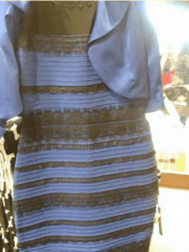
The Dress Phenomenon
Notes:
The dress is a photograph that became a viral internet sensation on 26 February 2015, when viewers disagreed over whether the dress pictured was coloured black and royal blue, or white and gold.
The phenomenon revealed differences in human colour perception,
Let’s take a vote: Who sees:
White and Gold
Black and Blue
The photo originated from a washed-out colour photograph of a dress confirmed as black and blue

Slide 8
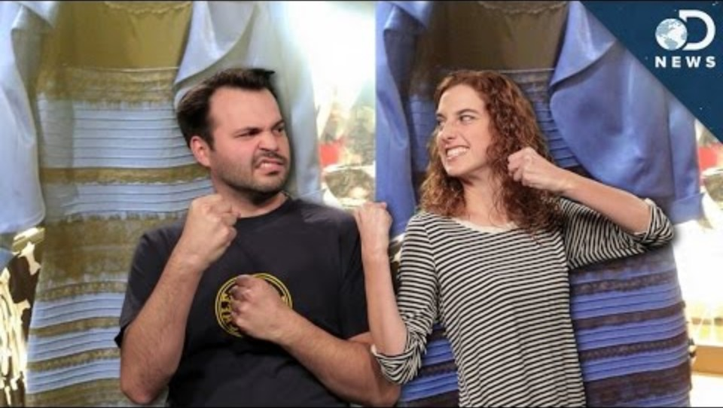
What #TheDress Tells Us About Color Perception
Notes:
BEFORE VIDEO:
If colour perception is created by the brain, then two people can sometimes see the same thing differently. Let's look at one of the most famous examples of this phenomenon.
AFTER VIDEO:
The important takeaway isn't whether the dress is blue and black or white and gold. The key lesson is that colour is influenced by context, lighting, and how our brains interpret visual information.
What #TheDress Tells Us About Color Perception
By Seeker
https://youtu.be/LaC8fVbHuYk?si=E7CzCxGI9pvRS_lc

Slide 9
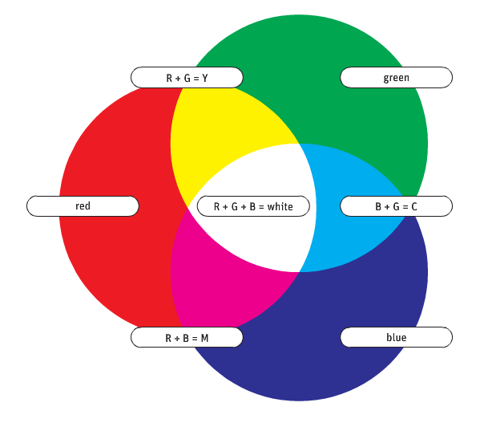
Additive Mixing (RGB)
Artificial Colour through
television sets,
computer monitors,
cameras, and
colour scanners
all produce mixtures of red, green, and blue light.
Notes:
Designers working with rays of coloured light, as on computer screens, they use additive colours, or RGB.
When these colours overlap, other colours are produced:
red and blue light form cyan;
red and green light form yellow; and
green and blue light form magenta.
When all three additive primaries overlap, white light is produced.
Thus, white light is the combined presence of all colour wavelengths.
We call them additive because all together, these primaries create white.
RGB reﬂects actual human colour receptors.
Mixtures of these primary colours produce a large part of the human colour experience.

Slide 10
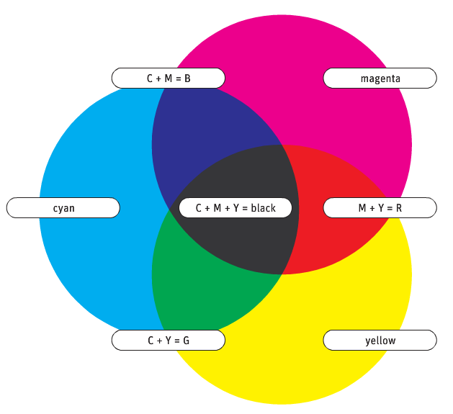
Subtractive Mixing (CMYK)
There are two sets of subtractive primary colours
Set one - the printer’s primaries
cyan,
magenta, and
yellow (CMY)
Add black, known as K, we get CMYK, or four-colour process.
Notes:
All objects have physical properties that cause them to absorb some colour waves and reﬂect others.
colour, when applied to a surface such as canvas or paper, has the same characteristic.
The sensation of colour is produced when a surface absorbs all the wavelengths except those the eyes perceive.
When colour is experienced through reﬂected light, it is called subtractive.

Slide 11
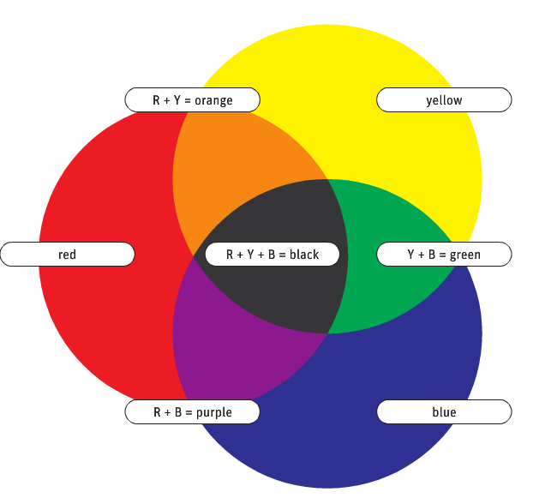
Subtractive Mixing (RYB)
Set two - the artist’s primaries:
red,
yellow, and
blue (RYB)
Notes:
In the RYB triad,
red combines with yellow to produce orange,
red and blue create violet (purple), and
blue and yellow create green.
RYB, the primary colour system used in art classes, forms the basis of most colour theory.
As with CMYK, when all the primary colors are combined, black is produced—no color is reﬂected.

Slide 12

RGB vs CMYK: Why Colours Change
RGB
Screen-based
Light-producing
Wider colour range
CMYK
Print-based
Ink-based
Smaller colour range
Notes:
A common frustration for designers is creating something on screen that looks amazing and then seeing it printed differently.
RGB uses emitted light.
CMYK uses reflected light.
Image from https://sl.bing.net/jpIsNkj1joq

Slide 13
RGB vs CMYK: Why Colours Change
RGB
Screen-based
Light-producing
Wider colour range
CMYK
Print-based
Ink-based
Smaller colour range
Notes:
Because ink cannot reproduce every colour we see on a monitor, some colours become duller when printed.
Bright neon greens, vivid blues, and highly saturated oranges are common examples.
This is why professional designers determine the final output before starting a project.
Image from https://sl.bing.net/jpIsNkj1joq

Slide 14
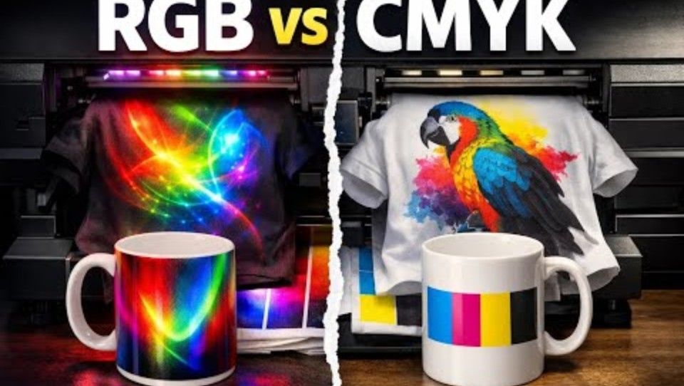
RGB vs CMYK Explained
Notes:
We've talked about the difference between colour created with light and colour created with ink. This short video does an excellent job of showing why designers often experience colour shifts when a project moves from screen to print.
IN CASE THEY ASK: An ICC profile (International Color Consortium profile) is a set of data that describes how colours should appear on a particular device, such as a monitor, printer, or press. It ensures that the colours you see on your screen match the colours that get printed, helping designers, brands, and printers maintain consistent and accurate colourconsistent and accurate color across different devices and materials. (What is an ICC Profile: The Complete Definition: https://www.globalvision.co/glossary/icc-profile)
RGB vs CMYK Explained, Choose the Right ICC Profile for Accurate Printing
By Subli Genius Print
https://youtu.be/S3LlcQcpEOA?si=kllVUgc55r3vKIXl

Slide 15
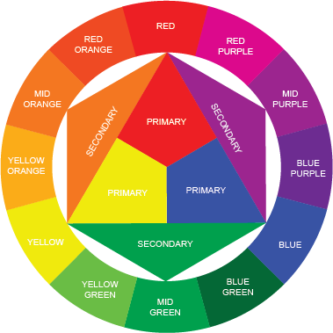
What is Colour Theory?
System for understanding how colours interact
Guides mood, balance, and visual impact
Notes:
Colour theory is a set of guiding principles that can be used to create harmonious colour combinations.
These ideas are represented in a variety of diagrams— colour wheels, triangles, and charts -- that help designers/artist
understand colour interactions,
select and combine colours, and
construct pleasing and effective palettes.
Diagrams such as this colour wheel, which shows pure hues as well as tints and shades, serve as a guide for selecting and combining colours beyond the pure hues.

Slide 16
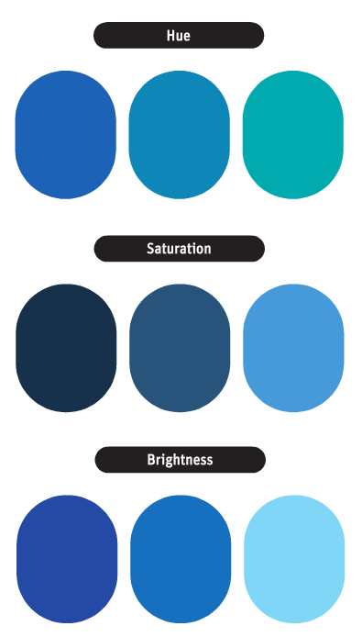
Key Terms
Hue – basic colour name (red, blue, yellow)
Saturation – intensity of colour
Value – lightness or darkness
Notes:
Hue
…is the common name of a colour that indicates its position in the visible spectrum or on the colour wheel.
Hue is determined by the speciﬁc wavelength of the colour in a ray of light.
The description of a hue can be made more precise in comparison to the next hue (e.g., a certain blue might be more accurately called blue-green).
Saturation
…refers to the intensity, strength, purity, or chroma—the absence of black, white, or gray—in a colour.
A vivid colour has high or full saturation,
whereas a dull one is desaturated.
Saturation is a measure of the richness of a colour.
Value
… or brightness, is the relative degree of lightness or darkness of a colour, or its reﬂective quality or brilliance.
A colour can be more narrowly described as either light or dark (e.g., light blue or dark blue).
The brightness of a colour is changed by mixing it with white (to form a tint) or with black (to form a shade) in varying proportions.

Slide 17
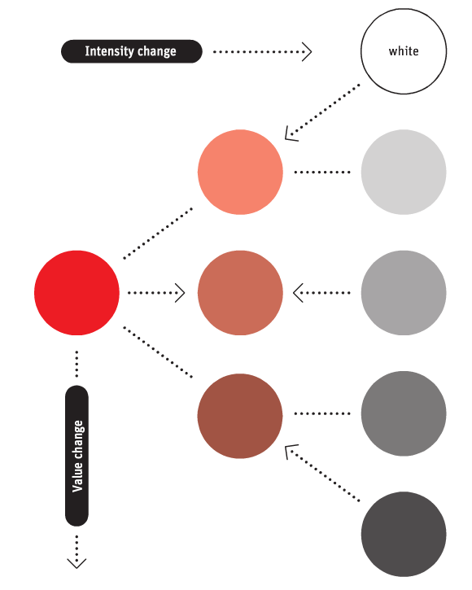
Properties of colour
Value change happened with addition of black or white
  Add white, hue’s value is lighter and less saturated
  Add black, hue’s value is darker and less saturated
Saturation (intensity) is lowered with the addition of gray, BUT value is unchanged
Notes:
This chart demonstrates changes in saturation and value by adding or subtracting black, white, or gray.
When white is added to a bright red, the value is lighter, and the resulting colour is less saturated.
Adding black to the red results in a dark red closer to the neutral scale because of saturation changes.
If gray is added, the saturation is lowered, but the value is unchanged.

Slide 18

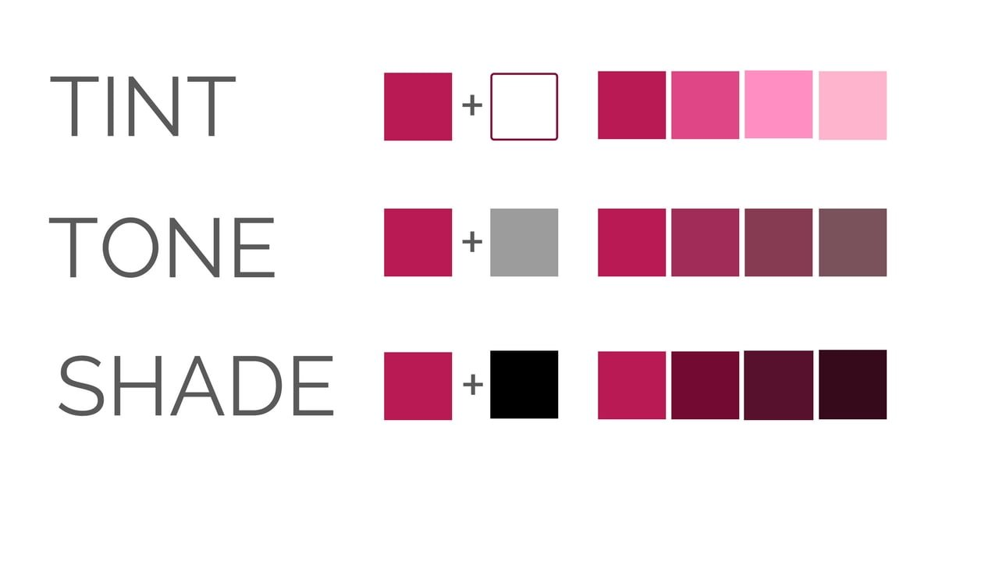

Tints, Shades & Tones
Tint = Hue + White
Tone = Hue + Gray
Shade = Hue + Black
Notes:
Designers rarely use pure colours all the time.
To create depth and hierarchy, we alter colours.
Adding white creates a tint.
Adding gray creates a tone.
Adding black creates a shade.
Understanding these variations helps us build sophisticated colour palettes instead of relying on pure, highly saturated colours.
Image from https://sl.bing.net/tqeYl02I9c

Slide 19
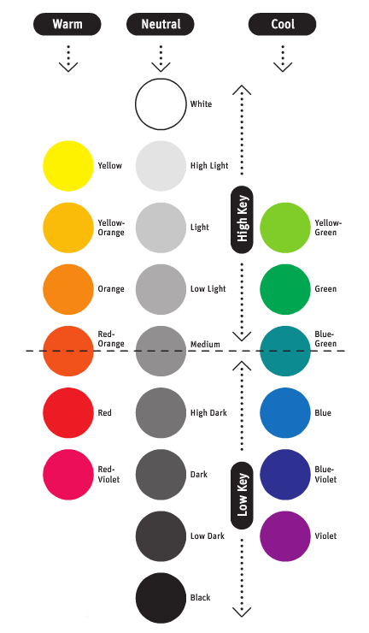
Key Terms
Temperature – warm vs. cool colours
Neutral colours - NOT hues: white, gray, black
High Key/Low Key -
Notes:
This chart shows relative values of hues at their maximum saturation.
Warm, cool, and neutral relationships are also indicated.
The dotted rule indicates the midpoint. All colours above the line are high key, while those below the line are low key.
"high key" refers to a scene dominated by bright, light-value colors, creating a cheerful, airy, and high-contrast effect, while
"low key" uses dark-value colors with minimal highlights and more shadows, resulting in a moodier, more dramatic, and low-contrast scene.

Slide 20
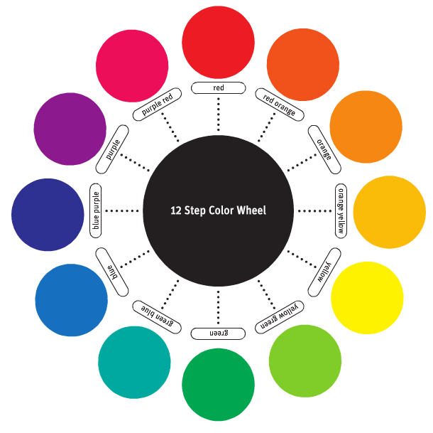
12-Step colour Wheel
Notes:
Colour theory is, at its core, about developing aesthetically pleasing colour relationships.
One of the best tools for visualizing colour relationships is the colour wheel. This wheel, originally developed by Sir Isaac Newton, can be constructed with just a few colours, or can be quite complex, incorporating many colour variations.
Perhaps the most useful version is the twelve-step colour wheel containing twelve pure hues, as shown.

Slide 21
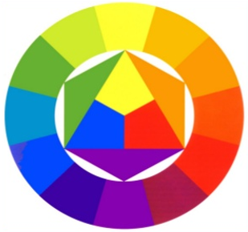
Primary Colours
Yellow
Yellow, Red and Blue
Blue
Red
Notes:
Primary colours:
There are three primary colours.
They are the hues yellow, blue and red.
These three colours are the hues that in theory can be mixed to make all other colours.
If you mix the three primary colours, in theory it would produce black.
Red, yellow, and blue are the primary colors of the artists' spectrum.
They are the simplest hues.
They cannot be broken down visually into other colors or reduced into component parts.
The primary colors are the most different from each other because they have no elements in common.
All colors on the artists' spectrum are mixed visually from the primaries red, yellow, and blue.

Slide 22
Secondary Colours
Created by mixing equal parts of two primary colours
Green = Yellow + Blue
Orange = Yellow + Red
Violet = Blue + Red
Green
Orange
Violet
Notes:
green, orange, and violet are the secondary colors of the artists' spectrum. Each secondary color is an even interval, or visual midpoint, between two primary colors:
Green is the middle mix of blue and yellow.
Orange is the middle mix of red and yellow.
Violet is the middle mix of blue and red.
The secondary colors are less contrasting in hue than the primary colors. Each secondary color contains a primary in common with one of the others. Orange and violet each contain red, orange and green each contain yellow, and green and violet each contain blue.
Yellow-orange, red-orange, red-violet, blue-violet, blue-green, and yellow-green are the intermediate colors. They are the midpoints between the primary and secondary hues. Like the secondary colors, each is made up of two primaries, but in different proportions. Many times these colors are referred to as tertiary colors, but this is inaccurate. Tertiary colors contain three primary colors, not two.⁴
Secondary colours:
Secondary colours: By mixing two primary hues together you create a secondary colour. There are three secondary colours. They are the hues green, violet (purple) and orange. Orange from mixing red and yellow, violet (purple) from blue and red, and green from yellow and blue.

Slide 23
Tertiary Colours
Created by mixing one secondary colour and one primary colour
When naming tertiary colours, primary colour is listed first and secondary colour is listed second
Yellow
Green
Yellow
Orange
Blue
Green
Red
Orange
Blue
Violet
Red
Violet
Notes:
Yellow-orange, red-orange, red-violet, blue-violet, blue-green, and yellow-green are the intermediate colors. They are the midpoints between the primary and secondary hues. Like the secondary colors, each is made up of two primaries, but in different proportions.
Tetiary colours:
Tertiary colours: The third set of hues are known as tertiary or intermediate colours. These hues are made by mixing adjacent primary and secondary hues. The six tertiary or intermediate colours are yellow-green, blue-green, blue-violet, red-violet, red-orange, and yellow-orange.

Slide 24
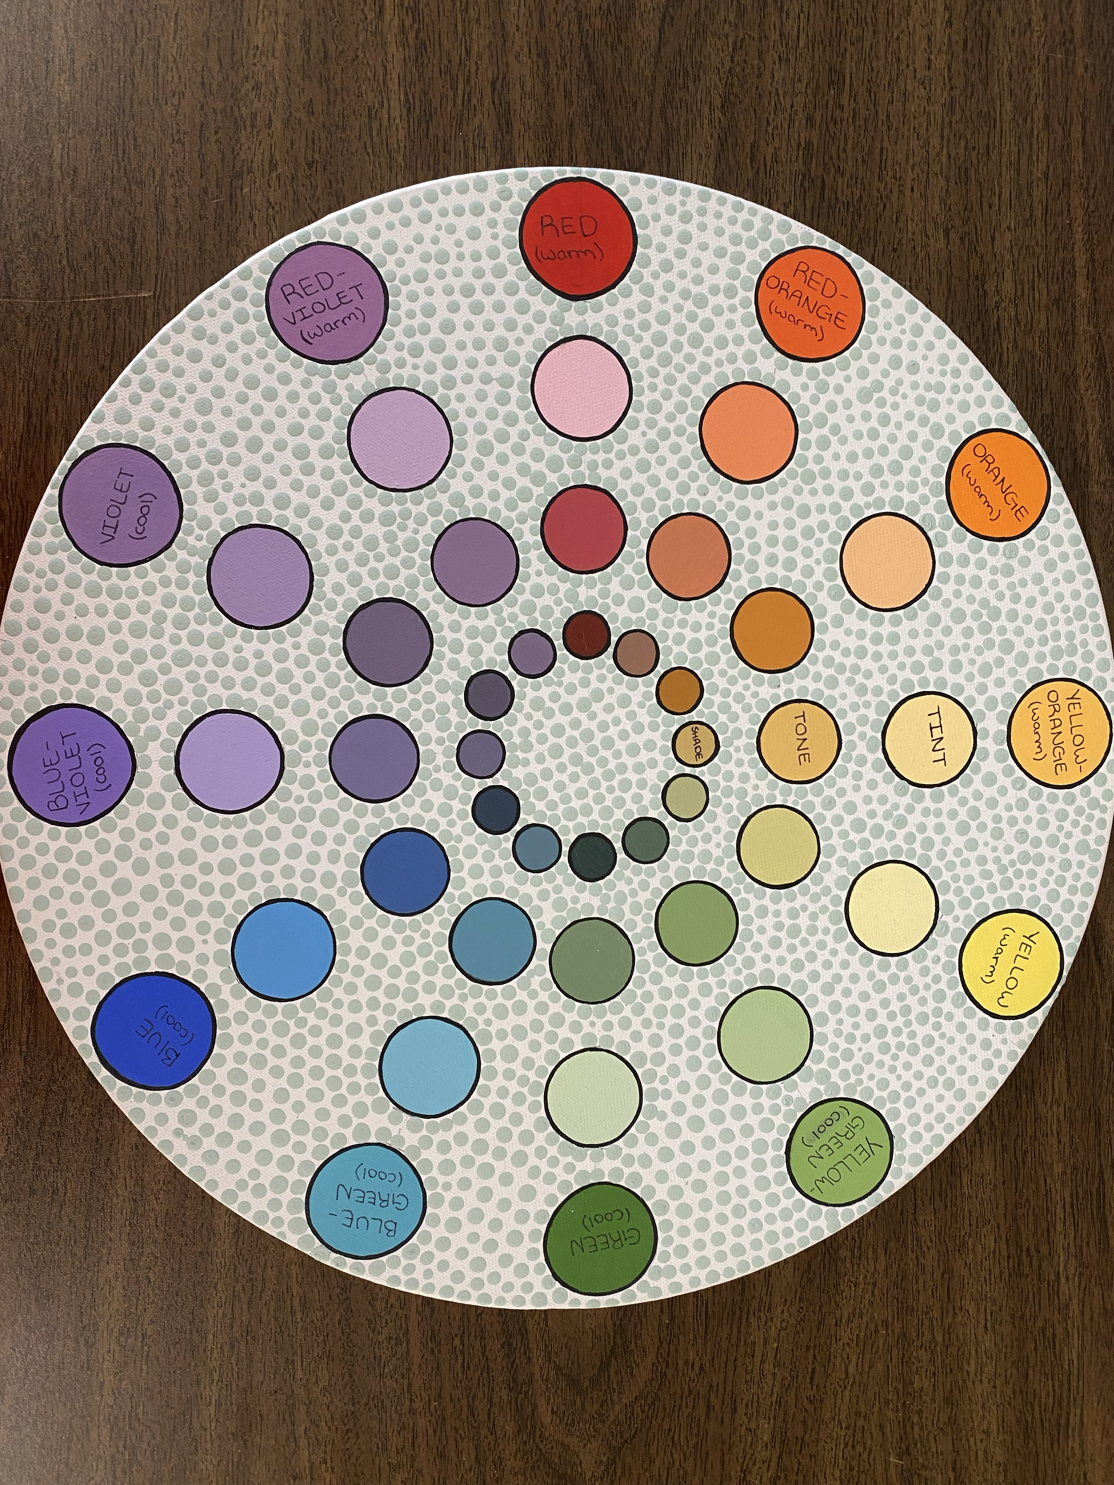
Activity: Colour Wheel

